Slide 1
NPTEL
Video Course on Machine Learning
Professor Carl Gustaf Jansson, KTH
Week 5 Machine Learning enabled
by prior Theories
Video 5.1 Machine Learning enabled
by prior Theories

Slide 2
Subthemes of Machine Learning enabled by prior Theories
Themes related to mixed Inductive, Deductive and Abductive scenarios
Explanation Based Learning (EBL) - separate lecture
Inductive Logic Programming (ILP) - separate lecture
Reinforcement Learning (RL) - separate lecture in three parts: I..III.
Various other theory based learning techniques:
Case-Based Reasoning (CBR) - separate lecture
Learning of Bayesian Belief Networks
Model-based Clustering.

Slide 3
Inference techniques
Deduction
Derive a conclusion from given axioms (domain knowledge) and facts (observations). The conclusion can be derived by applying inference schemes such as natural deduction (e.g. modus ponens) and resolution.
Induction
Derive an axiom (general rule) from observations and possibly some background knowledge. Induction is the main inference mechanism for learning.
Abduction
From a known axiom (theory) and some observation, derive a premise (using a rule backwards). Abduction is a core element of explanations and has a strong relation to causation.
Explanation-based learning
Enables a spectrum of inferences from abduction to deduction
Inductive Logic programming
Enables primarily structured combinations of deduction and induction

Slide 4
Explanation Based Learning (EBL)
Explanation-based learning (EBL) creates general problem solving schemata by observing and analyzing solutions to specific problems.
EBL spans the spectrum from deduction to abduction:
uses prior knowledge (domain theory) to ´explain´ why a training example is an instance of a concept
the explanations identify what features (predicates) are relevant to the target concept.
Prior knowledge is used to reduce the hypothesis space and focus the learner on hypotheses that are consistent with that knowledge.
Accurate learning is possible even in the presence of very few training instances. There is an obvious trade-off between:
the need to collect many examples to be able to induce without prior knowledge and
the ability to explain single examples in the presence of a strong domain theory.

Slide 5
Inductive Logic Programming (ILP)
The goal of ILP is to find general hypotheses expressed as logic programming clauses, from a set of positive and negative examples possibly in the presence of a domain theory.
Advantages of ILP
Possibility to express examples, hypotheses and domain(background) theory in the same formalism
Handling deduction and induction within the same framework.
Convenient handling of structured data and multiple relations as needed for e.g. descriptions of chemical molecules.
Some ILP systems can also invent new predicates and add them to the Domain theory.
Given:
• a set of positive E+ and negative E- training examples expressed in an ´observation language´ LE.
• a Domain Theory T
• a hypothesis language LH that delimits the clauses that are allowed in the hypotheses space H,
• a relation covers(e, H, B) which determines the classification of an example e with respect to H considering B.
Find a hypothesis h ∈ H that covers
all positive examples (completeness)
no negative examples (consistency).

Slide 6
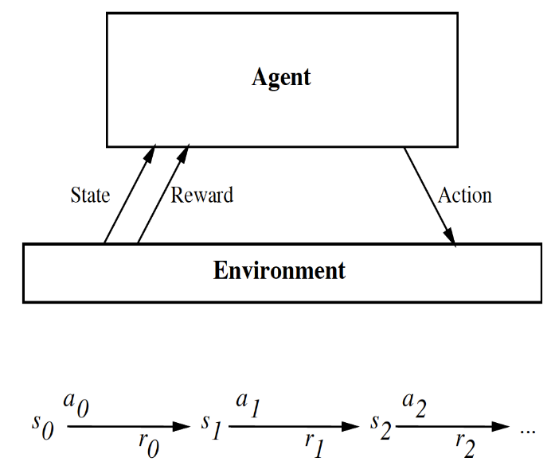
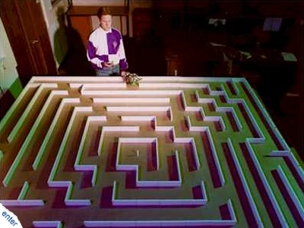
Reinforcement Learning (RL)
The intuitive scenario for Reinforcement Learning is an Agent that learns from interaction with an Environment to achieve some long-term goals related to the State of the environment by performing a sequence of actions and by receiving feedback.
The mapping from states to possible actions is called a Policy.
The satisfaction of goals is defined by Rewards or reward signals being the feedback on actions from the environment.
The Return is defined as the cumulative rewards over an Episode = action sequence, leading to a Terminal state.
The goal of any RL algorithm is to establish a policy that maximizes the Returns.

Slide 7
Case-Based reasoning (CBR)
Case-Based reasoning (CBR), is the process of solving new problems based on the experiences from solutions of similar past problems. Expressed in an alternative fashion, CBR does solve a new problem by remembering previous similar problems and by reusing knowledge of successful problem solving for those problems.
Case-based reasoning can be motivated by assumptions such as:
Similar problems have similar solutions
Many domains are regular in the sense that successful problem solving schemes are invariant over time.
Case-based reasoning should be contrasted by Rule-based reasoning.
Cases are stored in a case-base or case memory to be retrieved and reused. When a successful solution to the new problem is found, an adapted case can be stored in the case-base to increase its competence, thus implementing a learning behavior.
Technically, case-based reasoning is primarily supported by the techniques described in the previous lecture on Similarity based learning or Memory based learning. Particular examples here are the schemes for distance and similarity measures.

Slide 8
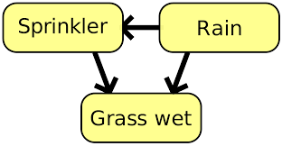
Learning of Bayesian Belief Networks
A Bayesian Belief Network (BBN) is a probabilistic graphical model that represents a set of variables and their conditional dependencies describing effects in terms of causes. Structurally a BBN is a Directed Acyclic Graph (DAG).
Inferences typically aims to update our beliefs concerning causes in the light of new evidence.
Bayesian inference derives the posterior probability of the subset of hypothesis variables through systematic use of Bayes theorem : P(H|E) = P (E|H) * P(E) / P(H). Inferences of this kind can be recursively applied throughout the whole structure.
Learning for BBNs
PARAMETER learning
Learning parameters (conditional probabilities) given a fixed variable structure
STRUCTURE learning
Learning the variable structure
Learning new hidden variables (non observables).
H H
P(E|H) P(H|E)
E E

Slide 9
Model-based clustering
Model-based Clustering means that clustering is based on some model or background knowledge (typically statistical) about the domain from which the instances of the dataset is harvested.
More or less synonymously one can talk about distribution-based clustering or statistical-based clustering.
The model can be more or less extensive but will in all cases guide the clustering process to some extent. Model-based clustering can in principle be an extension to any of the other clustering approaches.
The most common case is that statistical distributions are known or hypothesized for the instances of the aimed for clusters.
Examples of model-based methods are:
Gaussian mixture models, where the data set is usually modeled with a fixed number of Gaussian distributions that are initialized randomly and whose parameters are iteratively optimized to better fit the data set.
- Clustering based on Bayesian statistics techniques like AUTOCLASS.
- Conceptual clustering techniques exemplified by systems like COBWEB or CLASSIT.

Slide 10
NPTEL
Video Course on Machine Learning
Professor Carl Gustaf Jansson, KTH
Thanks for your attention!
The next lecture 5.2 will be on the topic:
Explanation Based Learning

